Slide 1
Forsyth County Schools
International Baccalaureate Programs
located at South Forsyth High School
IB Information Night
Notes:
Pam Bibik - welcome & intro
Recommend talk about OOD briefly and emphasize why we think coming to SFHS as a FRESHMAN rather than waiting till JUNIOR year is wise. Other?

Slide 2
What is “IB”?
…(aims) to develop inquiring, knowledgeable and caring young people who help to create a better and more peaceful world through intercultural understanding and respect…(IB) programmes encourage students across the world to become active, compassionate and lifelong learners who understand that other people, with their differences, can also be right.
Quick History/Global Nature
South is the ONLY IB in the district
Only 35 IB Diploma Programs in Georgia
Only 11 IB Career Programs in Georgia
Notes:
Transition from Pam with the mission statement to Denney with the rest

Slide 3
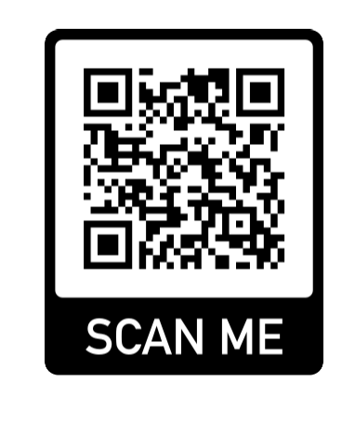
Questions & Answers?
If you would like to submit a question, please scan the QR code and read the FAQs. If you have an additional question, please use the link to submit it. We will do our best to answer all submitted questions.
Notes:
Graham or admin
Use to type in specific questions about the program as we present. We will try to address some of these at the end of the presentation, and the rest we will post answers to the website as a FAQ

Slide 4
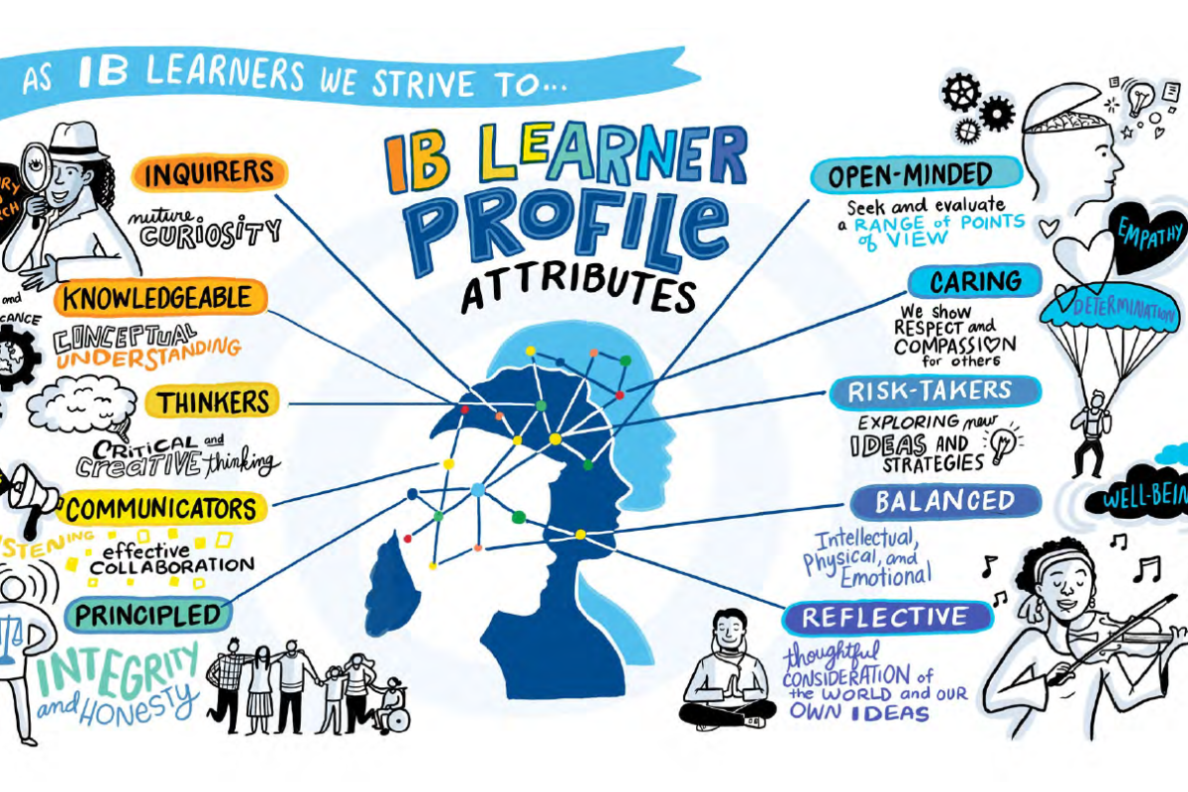

Slide 5
AP or IB, that is the question…
AP
IB
Classes stand alone
Externally assessed
Grading scale 1-5
3 is a “passing” score
Large selection of classes
Can pick and choose subjects to take by preference
Has a whole student component in Capstone
High rigor
Quality point adjustment to GPA
College level coursework/ curriculum
Potential college credit
College recognition
of challenge
Interdisciplinary
Internally and externally assessed
Grading scale 1-7
4 is a “passing” score
Specific curriculum requirements across the disciplines
Develops whole student (CAS, EE, TOK)
Notes:
Denney “All three advanced studies programs at South High begin for students in the 11th grade, so our rising-11th graders must come to a decision about which approach to take in January/February of their sophomore year. Both AP and IB coursework are college prep programs that provide the high rigor coursework that colleges are looking to see if high school students have challenged themselves with in high school. They both provide a quality point for GPA computation. Both the AP Capstone and the IB Career and IB Diploma Programs can only be taken in Junior and Senior years, IB courses may NOT be taken in sophomore or freshman years. For both AP & IB, students can potentially gain a college credit for the course depending on the credit policies for each individual university. As to differences, AP coursework tends to stand alone with little connection provide to other courses. IB programs strive to develop the whole student and make connections between subjects throughout the two years. For any of these programs – AP Capstone, IB Diploma or IB Career – there is an application to complete online but it does not need to be completed until February 24th for rising-11th graders this year.”

Slide 6
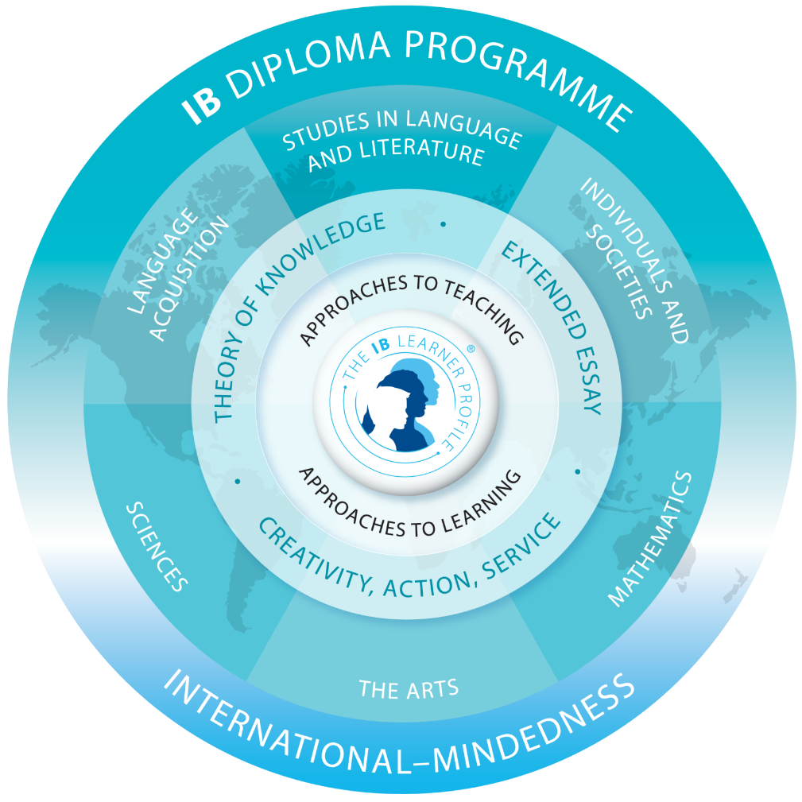
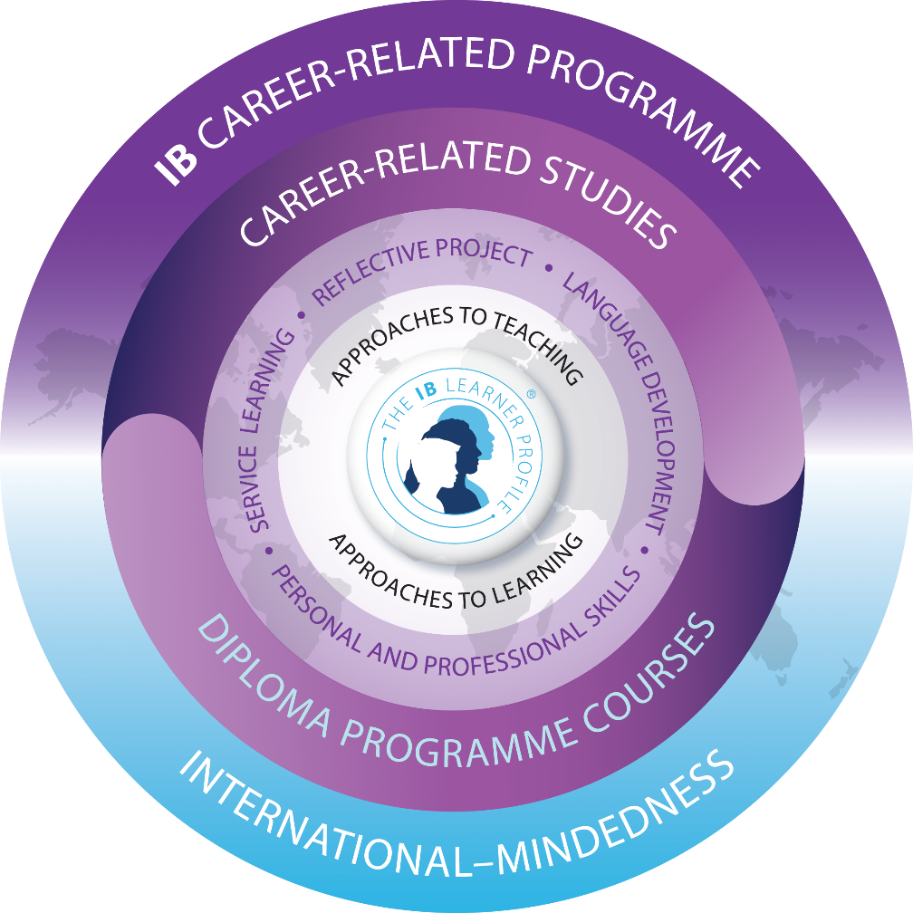
Two Programs
IB is a Whole Student Program
Approaches to Teaching & Learning
Coursework
CORE
World Community
Diploma (DP)
Career-related (CP)
Notes:
Graham
Emphasize the student centered, wholistic approaches to the program with connections across the curriculum. Discuss how we encourage development of the Why not the What in learning
“For IB, there are two possible programs students can choose between. For those students with a passion for one of the Career Pathways the state provides coursework for several such as but not limited to our Marketing and Engineering pathways. These students might be interested in taking on the challenge of some IB coursework in the IB Career Related Program. For the more holistic subject approach across all subject areas, the Diploma Program may be the better choice, developing the student in all disciplines. Both programs are well received by colleges and universities and are seen as signs that high school students have challenged themselves at the highest levels of study.”

Slide 7
IB Diploma Program
Diploma Pass Rate Comparison
Year | SFHS | Georgia | USA | World
2008-2023 | 89% | 54% | 67% | 78%
IB Career-related Program
Career-related Completion Rate Comparison
Year | SFHS | Georgia | USA | World
2013-2023 | 92% | 87% | 76% | 84%
Notes:
Denney – discuss the long-term success of the IB Programs at South High

Slide 8
Coursework Required
Diploma
Career
Subjects Currently Available:
English Literature (HL)
French, German, Spanish & Latin (all HL or SL)
History (HL), Psychology, Business
Biology (HL), Chemistry, Physics (HL)
Math Analysis (Calculus) & Math Applications (Statistics)
Visual Arts (HL)
Courses potentially being added…
Computer Science
Music
Theater
Sports, Exercise & Health Science
6 Diploma Subjects
Three+ Higher Level (HL) = 2 year
Three- Standard Level (SL) = 1 year
2 Diploma Subjects
One+ Higher Level (HL) = 2 year
OR 2 year Standard Level Course*
One- Standard Level (SL) = 1 year
Required DP Subject Areas
Required DP Subject Areas
Math
Science
History
English
Foreign Language
6th Subject (Choices)
&
Theory of Knowledge course
ANY two DP
&
Personal & Professional Skills course
Plus
Career Pathway (both years)
World Language (50 hrs)
Notes:
Denney & Graham
Talk about Whole Student aspect of the IB Diploma Program, how it goes beyond just book learning and teaches how to learn, how subjects connect together and the development of the learner profile. TOK & PPS as connections & glue to tie it all together and think about
“The Diploma Program requires students take six IB courses through 11th and 12th grades, one in each subject. Additionally, they take a course called Theory of Knowledge that teaches them about how we know what we know and connects the subjects together holistically. The Career Program only requires two IB Diploma subjects of the students’ choice plus a course for career based soft skills called Personal & Professional Learning. Career Program students must also complete and pass the state course pathway assessments in one of the many career paths available for high school students in Georgia.” Discuss course offerings and potential new subjects we hope to add in the coming years.

Slide 9
In “common” = IB Assessments
Internal Assessment
External Assessment
Graded internally by the classroom teacher
Random samples sent worldwide to IB examiners for moderation of scores
Some Oral
Some Written
Some Visual
Some Product
Some Lab
Timed, standardized IB exams given at SFHS in May
All exams sent world-wide to IB Examiners for external grading
Scores communicated to school and students in July after the exams
Notes:
Denney
Discuss differences in assessment from AP

Slide 10
PAYOFF: College Course Credits
Scores of 4+ (IB scale is 1-7)
can earn credit
depending on college/university
Colleges are looking at the following characteristics when they evaluate candidates for admission to their campus:
Rigor of coursework undertaken by the prospective candidate
SAT & ACT Test scores
GPA*
Class Rank
Application Essay
Work/School Activities
Princeton Review sequence:
IB Diploma
IB Career & AP Capstone
Other graduates
PLUS: A number of states offer 24 hours of college credit to students who receive the IB Diploma including: Georgia, Florida, Texas, N Carolina & California
Notes:
Denney
Emphasis on what the parents/students/community see as value of program
We typically lose 5-10% of the junior class prior to entry into 12th grade from the full Diploma Program for various reasons, most typically deal with poor homework work ethic affecting student grades.

Slide 11
IB Students Graduate from College at Higher Rates
The 2011 study of IB students’ experiences after high school found that IB students graduated from college at higher rates, with 81% of IB students graduating within 6 years of enrolling full-time at a 4-year institution, compared to the national average of 57%.
January 1, 2012
Notes:
Graham
Emphasize that this is an outside study that shows similar comparison to AP study.
In the 2011 SRI International study of the post-secondary outcomes for nearly 25,000 Diploma alumni, researchers found that at institutions with high IB enrollments, graduation rates for IB students were generally higher than the institutional average. Overall, 81% of IB students graduated within 6 years of enrolling full-time at a 4-year institution, compared to the national average of 57%.

Slide 12
University or College | IB Students Acceptance Rate | Total Population Acceptance Rate | IB Students vs Total Population
University of Florida | 82% | 42% | +40%
Georgia Institute of Technology | 81% | 59% | +22%
Brown University | 18% | 9% | +9%
Stanford University | 15% | 7% | +8%
Columbia University | 13% | 9% | +4%
University of California - Berkeley | 58% | 26% | +32%
Harvard University | 10% | 7% | +3%
Davidson | 64% | 34% | +30%
Emory University | 78% | 42% | +36%
University of Miami | 72% | 30% | +42%
Source: IBDP Graduate Destinations Survey 2011/12 conducted by i-graduate International Insight
Strictly copyright © IGI Services 2011
January 1, 2012
Notes:
Denney
Sample acceptance rates. Note the difference between total population and IB students. This is an older study, but it pretty much mimics a prior study done independently and other information available to us.
The IB surveyed all IB world schools in the United States registering students for Diploma exams in May 2011 and all US 12th graders registered for exams about their college application process. According to student self-reports, IB students are admitted to college and universities at higher rates than the general population.
This slide shows the Universities most commonly applied to by US Diploma candidates, and demonstrates that IB students have higher acceptance rates than the average acceptance rates for the university.

Slide 13
University or College | IB Students Acceptance Rate | Total Population Acceptance Rate | IB Students vs Total Population
Cornell University | 31% | 18% | +13%
Duke University | 28% | 16% | +12%
University of Pennsylvania | 24% | 14% | +10%
Yale University | 18% | 7% | +11%
University of Georgia | 95% | 65% | +30%
Boston University | 70% | 58% | +12%
University of California - Los Angeles | 48% | 23% | +25%
University of Virginia | 64% | 32% | +32%
UNC Chapel Hill | 63% | 32% | +31%
Princeton University | 16% | 8% | +8%
Source: IBDP Graduate Destinations Survey 2011/12 conducted by i-graduate International Insight
Strictly copyright © IGI Services 2011
January 1, 2012
Notes:
Denney
Same as prior

Slide 14
What the Students Say
“Learn how to learn”
“You care about what you are learning.”
“Confidence builder”
“Fun studying – not alone but with peers in the same boat as you”
“There is a learning curve.”
“Is time for friends, is time for other things”
“It’s a program, not individual classes.”
“Sense of community: classmates, teachers, ancestors”
“Different way of thinking”
“Not just a humanities program”
“Teaches responsibility of an adult in high school (not college wakeup call)”
“All assignments are, at first, scary but they are doable; you are taught how.”
Notes:
STUDENT Presentation – Denney intro
Please bring the students up here, introduce themselves, indicate which school(s) they are hoping to be accepted to, etc.. I will send you a copy of the questions they were asked to know answers to.
Make sure Students talk, answer questions with Emphasis on:
Family Esprit de corps
Variety of Colleges
They do have social time
Many different activities outside class
Well rounded nature
Challenge – Joy of learning

Slide 15
Some of the Colleges SFHS IB Students Have Attended
Agnes Scott | Georgia Southern | Texas A&M
Amherst | Georgia State University | Tulane
Auburn University | Harding | United States Air Force Academy
Barnard | Illinois Kennesaw State | Universite de Nantes
Baylor University | Johns Hopkins | University of Alabama-Birmingham
Berry | Kennesaw State University | University of California – LA (UCLA)
Berry College | Kings College London | University of Chicago
Boston College | Louisiana State University | University of Eddinburgh
Bowdoin | Mass. Institute of Technology (MIT) | University of Florida
Brigham Young | McGill University | University of Georgia
Bryn Mawr | Mercer University | University of Maine
Cal Poly Pomona | Michigan | University of Miami (FL)
California Institute of Technology | New York University | University of North Carolina (both)
Clemson University | North Augusta | University of Oregon
College of Charleston | North Carolina State | University of Rochester
Converse | Northwestern | University of South Carolina
Cornell University | Notre Dame | University of Tennessee
Dartmouth | Oglethorpe | University of Toronto
Davidson | Ohio State University | University of Utah
Duke University | Oregon | University of Virginia
Elon | Oxford (at Emory) | Vanderbilt
Emory | Presbyterian | Virginia Tech
Flagler | Randolph-Macon | Washington College
Florida State | Rennsellaer Polytechnic Institute | Wesleyan
Furman | Rhode Island | West Point
George Washington | Rice University | Wheaton
Georgetown | SCAD | Wofford
Georgia Institute of Technology | Sorbonne Institute (Paris) | Yale
Notes:
Denney/part of STUDENT Presentation?

Slide 16
Dispelling Myths & Rumors
True or False?
Students in IB cannot take DE Georgia Tech math.
FALSE
Many IB CP students take dual enrollment Georgia Tech math along with their IB requirements.
Diploma students, however, do not have room for dual enrollment classes because they are taking a full load of college level courses already.
Notes:
Graham
Emphasize the student centered, wholistic approaches to the program with connections across the curriculum. Discuss how we encourage development of the Why not the What in learning

Slide 17
Dispelling Myths & Rumors
True or False?
IB Program is more rigorous and IB students do so much more homework than AP students
FALSE
Both programs have college level coursework. The homework load depends more on “how many” such courses you are taking – not which program it is. Many AP students take more AP offerings and thus have a larger homework/study load.
Notes:
Denney
Emphasize the student centered, wholistic approaches to the program with connections across the curriculum. Discuss how we encourage development of the Why not the What in learning

Slide 18
Preparing for Advanced Studies
Recommended Coursework
9th Grade: FreshmanYear
10th Grade: Sophomore Year
Graduation Requirements
Two Honors or Accelerated or AP courses
World Language
Begin a Career Pathway Course
Graduation Requirements
Two Honors or Accelerated or AP Courses
Continue in the same World Language
Begin a Career Pathway or continue in career pathway from 9th grade
Notes:
Denney
For rising-9th graders we recommend that they take coursework that will help ready them for the more rigorous work they will tackle upon entering the IB programs in their junior year. We suggest they balance their studies but that they take at least 2 or more honors level courses or higher both as a 9th grader and as a 10th grader. We also recommend they continue to develop their Language Proficiency in either Spanish, German or French in 9th and 10th grades. We also recommend they start a Career Pathway they are interested in as a 9th or 10th grader to explore their options and interests before narrowing down as an 11th grader.

Slide 19
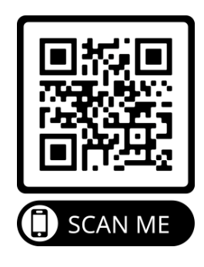
Out of District Details
OOD requests must be submitted online between October 16st to November 17th, 2023. The district will notify applicants regarding your application via email.
Please do not contact SFHS regarding OOD requests. This will be handled through the County Office.
Students who request OOD for the International Baccalaureate Program at SFHS will only be considered if they meet the prerequisite criteria.
Notes:
Denney/Graham/Wolff/Hewitt/Bibik
“If you are the parent of a student who is NOT districted to attend South Forsyth High School next year, you will need to complete the Out of District application no later than January 18th. For any student planning to participate in the IB programs in 11th and 12th grades, we actually recommend they start their high school experience at South High. This is so they can develop relationships with students, teachers and coaches that will extend through their entire high school experience rather than coming in cold as an 11th grader.” Again, the OOD deadline is Jan 18th this year. Should you apply, you will be notified by email in February.”
***Admin wanted to add that I believe two years back b/c of issues with parents waiving over teacher recs. Still have that problem so should at least mention it probably. Will delete if you really want off

Slide 20
Questions?
Tom Wolff, AP Coordinator
twolff@forsyth.k12.ga.us
770-781-2264 ext. 100117
Kevin Denney, IB Diploma Coordinator
kdenney@forsyth.k12.ga.us
770-781-2264 ext. 101150
Tera Graham, IB Career-related Coordinator
tgraham@forsyth.k12.ga.us
770-781-2264 ext. 101147
School Website: www.forsyth.k12.ga.us/sfhs/site/default.asp
Click the Academics tab, then Advanced Studies, then choice of Programs
Notes:
Graham
“Here is the contact information for each of the three program coordinators. If you have further questions or would like to know what next steps are for you, please reach out to one of us to help you through the application and registration process this coming spring. Good luck in your registration decision making.”

